Slide 1

50 Shades of Data - how, when and why Big, Fast, Relational, NoSQL, Elastic, Event, CQRS
Lucas Jellema
AMIS (The Netherlands)
@lucasjellema
technology.amis.nl
GitHub: https://github.com/lucasjellema/order-data-demo-devoxx
#DevoxxMA
Notes:
50 Shades of Data - how, when and why Big,Relational,NoSQL,Elastic,Event,CQRS
Data has been and will be the key ingredient to enterprise IT. What is changing is the nature, scope and volume of data and the place of data in the IT architecture. BigData, unstructured data and non-relational data stored on Hadoop, in NoSQL databases and held in Elastic Search Indexes, Caches and Message Queues complements data in the enterprise RDBMS. Emerging patterns such as microservices that contain their own data, BASE, CQRS and Event Sourcing have changed the way we store, share and govern data. This session introduces patterns, technologies, trends and hypes around storing, processing and retrieving data using products such as MongoDB, MySQL, Kafka, Redis, Elastic Search and Hadoop/Spark -locally,in containers and on the cloud
Key take away: what an application architect and a developer should know about the various types of data in enterprise IT and how to store/manage/query/manipulate them. What products and technologies are at your disposal. How can you make these work together - for a consistent (enough) overall data presentation.
The presentation structure:
Show tag cloud of recent acronyms and terms around data in IT; establish the fact that a lot is happening.
What are drivers? IT economics, Technology , insights and experiences, architecture designs,
Major trends: big data/fast data (incl; IoT), domain driven design, microservices, CQRS & derived data, event sourcing, normalization no longer the holy grail; the cloud; BASE vs ACID; scale (global, 24/7), B2B and Public Registries, Open APIs, machine learning
Types of data (usage) and typical requirements for each
Technologies/products per category - demo, code samples, cloud services
Special theme: How to go about managing the data owned by microservices
Role of SQL as the almost uniform access tool for all data
How to combine the various data stores - to prevent (too much) inconsistency/lag of integrity (CDC, event based, synchronization) and distributed queries across shards and across technologies

Slide 2


Who am I?
From The Netherlands, father of two sons
#devoxxma

Slide 3





Felicitations!
#devoxxma

Slide 4
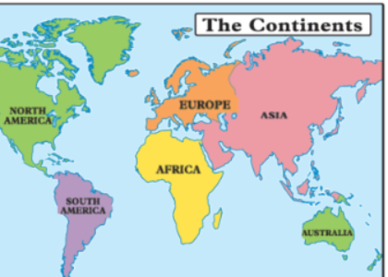

Who am I?
From The Netherlands, father of two sons
Masters in Applied Physics
Started in IT in 1994: Oracle; now CTO of AMIS
Solution Architect for enterprise IT challenges
Oracle ACE Director, Oracle Developer Champion, Java Rockstar
Presenter: Oracle OpenWorld, JavaOne, NLJUG JFall/JSpring, Javapolis/Devoxx, YouTube
Author of two books on Oracle SOA Suite, 1400 blog articles and 7000+ Tweets
#devoxxma

Slide 5

What is data?
#devoxxma

Slide 6
What is data?
A solidified representation of
An observation [of a fact]
A concept
Serialized in order to be
Understood & processed by machines
Reproduced for human consumption
#devoxxma

Slide 7
When things were simple
RDBMS
SQL
ACID
SAN
Backup
Backup
Data files
Log Files
Backup
#devoxxma

Slide 8
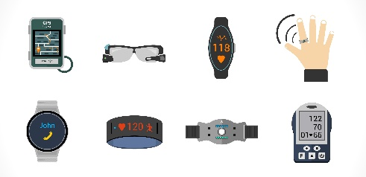
And then stuff happened
Mobile App (offline)
Client Tier: Browser
Mobile App (offline)
Client Tier: Browser
Mobile App (offline)
API
Client Tier: Browser
API
API
µ
λ
Middle Tier:
Java EE (Stateful) application
Fast Data
XML, JSON
Data Warehouse
Content Management
Big Data
#devoxxma

Slide 9
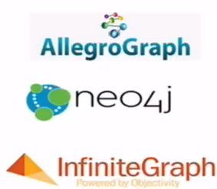


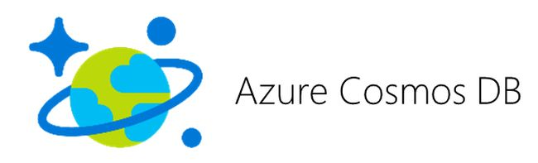

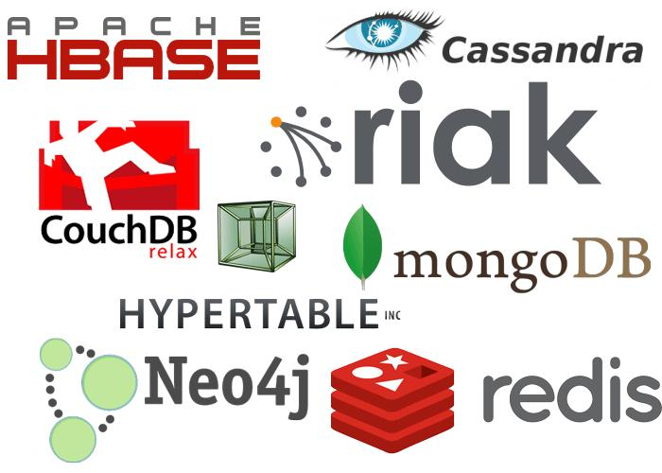






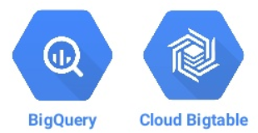
Explosion of Data Store technologies
RDBMS
SQL
ACID

Slide 10
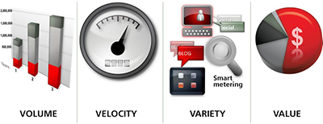
V⁴
#devoxxma

Slide 11
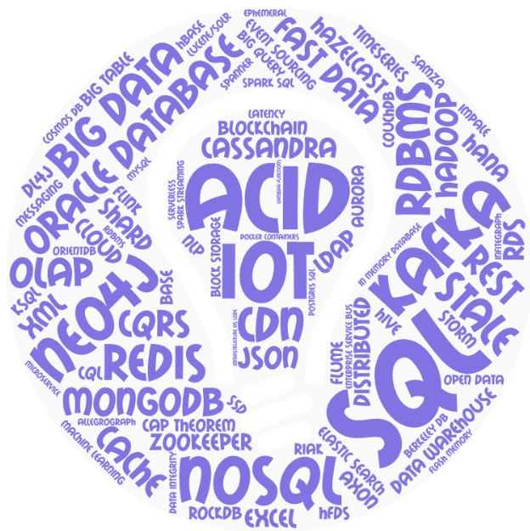
Tagcloud
#devoxxma

Slide 12
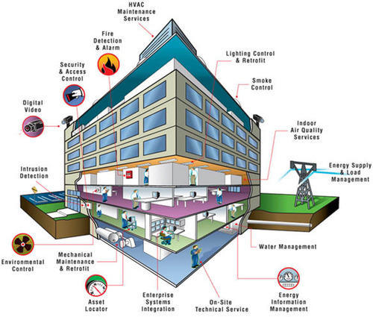
Business Areas
Customers
Supplier
Gov Agency
Data providers
Sales & Customer Service
External Actors
Inside the Enterprise
Security
Inventory & Warehousing
Order Management
Shipping
Output (print & mail, email, SMS, …)
Customer Management
Supplier & Product Management
Finance
Accounts, Invoices
Marketing & Campaigns
Data Department
Consolidation, MI, Reporting, Analysis and R&D

Slide 13

Business Applications
Customers
Supplier
Gov Agency
B2B APIs
DaaS Services
APIs
Data providers
Mobile App
B2B APIs
Open Data APIs
Customer Service SaaS
WebShop Portal
B2B Partner Portal
Public Internet/External Actors
Inside the Enterprise
IoT Gateways & Hub
Security & Compliance Monitor
Recommendation Engine
Human Workflow Engine
Communication & Collaboration tools
Security
Inventory & Warehousing
Order Management
Shipping
Mail Server
Custom Application for Product Catalog
Output (print & mail, email, SMS, …)
LDAP for Users, Roles & Permissions
Asset Tracker
Custom Order Management Application
SaaS ERP
Enterprise Dashboard & BI & Reporting
Customer Management
Supplier & Product Management
Finance
Accounts, Invoices
SaaS CRM
Data Warehouse
Desktop Tools
SaaS CX
Campaigns, Social Media Monitor, 360 Customer View
Enterprise Content Management System
Marketing & Campaigns
Data Department
Consolidation, MI, Reporting, Analysis and R&D

Slide 14
Business Applications & IT Systems
Supplier
Customers
Desktop Browser
Gov Agency
Email / Facebook / WhatsApp
Mobile Devices
B2B APIs
DaaS Services
APIs
Data providers
Mobile App
B2B APIs
Open Data APIs
Customer Service SaaS
WebShop Portal
B2B Partner Portal
API Gateway
Private Blockchain
Public Internet/External Actors
Inside the Enterprise
IoT Gateways & Hub
Security & Compliance Monitor
Recommendation Engine
Human Workflow Engine
Communication & Collaboration tools
Inventory & Warehousing
Service Bus
Security
Order Management
Shipping
Application Server
Rule Engine
Mail Server
Custom Application for Product Catalog
Output (print & mail, email, SMS, …)
LDAP for Users, Roles & Permissions
Asset Tracker
Custom Order Management Application
Event Bus
SaaS ERP
Enterprise Dashboard & BI & Reporting
Customer Management
Supplier & Product Management
Finance
Accounts, Invoices
Monitor for Application & Infra metrics
Source Code Control System
SaaS CRM
Job Scheduling
Event Bus
Data Warehouse
Desktop Tools
SaaS CX
Campaigns, Social Media Monitor, 360 Customer View
Enterprise Content Management System
Big Data Lake
Marketing & Campaigns
Data Department
Consolidation, MI, Reporting, Analysis and R&D
Docker Container Registry
Corporate Database
Logging Collector & Monitor & Analyzer
File Storage

Slide 15
Business & IT - Data
Supplier
Customers
Desktop Browser
List of Products shown in UI
Recent Consumer purchases information
Gov Agency
Email / Facebook / WhatsApp
Mobile Devices
B2B APIs
DaaS Services
Personal Profile, Order and Payments Details
APIs
Data providers
Footage from security cameras
Weather, Demographics, Sports, Social, …
Offers, invoices, rewards messages
Mobile App
B2B APIs
Open Data APIs
Customer Service SaaS
WebShop Portal
B2B Partner Portal
API Gateway
Private Blockchain
Smart Contracts with supply chain details
Case files (Complaints, Requests)
Public Internet/External Actors
Shopping Cart with selected items
API usage, billing, policies
Running & Past workflow instances
Inside the Enterprise
Readings from motion detectors
Audit Trails, Security Incidents
User Stories, Designs, Discussions
IoT Gateways & Hub
Security & Compliance Monitor
Recommendation Engine
Human Workflow Engine
Communication & Collaboration tools
Inventory & Warehousing
Service Bus
Security
Order Management
Shipping
Digital Twin
Config data
Application Server
ML Models
Rule Engine
Mail Server
Custom Application for Product Catalog
Output (print & mail, email, SMS, …)
LDAP for Users, Roles & Permissions
Asset Tracker
Custom Order Management Application
In Flight Messages
Event Bus
Rules & Rule Execution metrics
Order Details
SaaS ERP
Enterprise Dashboard & BI & Reporting
Application & Infrastructure source history
Emails regarding customer complaints
Customer Details
Customer Management
KPIs & Alerts
Supplier & Product Management
Finance
Accounts, Invoices
Monitor for Application & Infra metrics
Invoices & Payments
SaaS CRM
Events
Source Code Control System
Job Scheduling
Event Bus
Sales Aggregates by Day, Region, Product Category
Data Warehouse
Desktop Tools
Job Schedules
Customer Interaction records
Spreadsheets with Sales records
SaaS CX
Campaigns, Social Media Monitor, 360 Customer View
Enterprise Content Management System
Big Data Lake
Marketing & Campaigns
Data Department
Consolidation, MI, Reporting, Analysis and R&D
Programming in progress
Corporate Database
Logging Collector & Monitor & Analyzer
WebShop activity, Social Media discussions, …
File Storage
Copy of Production Data in Acceptance
Log-files from IT systems (infra & platform)
ML Models
Product Manuals

Slide 16

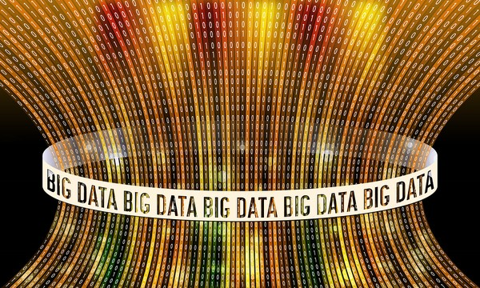
Volume
#devoxxma

Slide 17
Data Volume
Supplier
Customers
Desktop Browser
Recent Consumer purchases information
Gov Agency
Email / Facebook / WhatsApp
Mobile Devices
B2B APIs
DaaS Services
Big Lots of data
low
Personal Profile, Order and Payments Details
APIs
Data providers
Footage from security cameras
Small chunks of off line data
Weather, Demographics, Sports, Social, …
Offers, invoices, rewards messages
Mobile App
B2B APIs
Open Data APIs
Small payloads
Smart Contracts with supply chain details
Customer Service SaaS
WebShop Portal
B2B Partner Portal
API Gateway
Private Blockchain
Case files (Complaints, Requests)
Public Internet/External Actors
API usage, billing, policies
Running & Past workflow instances
Inside the Enterprise
User Stories, Designs, Discussions
Machine Learning models
Recommendation Engine
Human Workflow Engine
Communication & Collaboration tools
IoT Gateways & Hub
Security & Compliance Monitor
Rule meta-data (very small)
Inventory & Warehousing
Service Bus
Security
Order Management
Shipping
Digital Twin
Config data
Application Server
ML Models
Rule Engine
Medium size – structured data
Mail Server
Custom Application for Product Catalog
Output (print & mail, email, SMS, …)
LDAP for Users, Roles & Permissions
Asset Tracker
Custom Order Management Application
Event Bus
Rules & Rule Execution metrics
Order Details
Fine grained events
SaaS ERP
Enterprise Dashboard & BI & Reporting
Emails regarding customer complaints
Customer Details
Customer Management
KPIs & Alerts
Supplier & Product Management
Finance
Accounts, Invoices
Monitor for Application & Infra metrics
Invoices & Payments
Source Code Control System
SaaS CRM
Job Scheduling
Event Bus
Data Warehouse
Desktop Tools
Job Schedules
Piles of log-files
Customer Interaction records
Long term history Data Warehouse
SaaS CX
Campaigns, Social Media Monitor, 360 Customer View
Enterprise Content Management System
Big Data Lake
Marketing & Campaigns
Data Department
Consolidation, MI, Reporting, Analysis and R&D
Big Data Lake
Programming in progress
Corporate Database
Logging Collector & Monitor & Analyzer
File Storage
Gathering – never purging?
Log-files from IT systems (infra & platform)
ML Models
Product Manuals

Slide 18
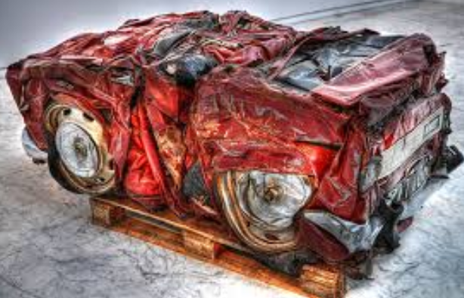
Compression
. Technical Compression
Same data, fewer bits to store
Same time – or even longer - to process
Logical Compression
Filter (older than, one in X)
Reduce fine grainedness - helicopterview
Average over geographical area
Min/Max/Average per minute/hour/day
Is typically done in data warehouse & digital twin
Could be done for query stores and even for big data set
#devoxxma
Notes:
https://specify.io/concepts/microservices

Slide 19


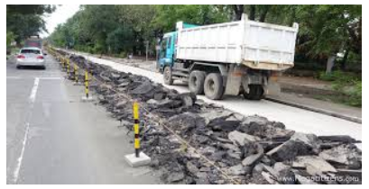
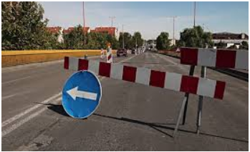
80M Pictures of Road
#devoxxma

Slide 20
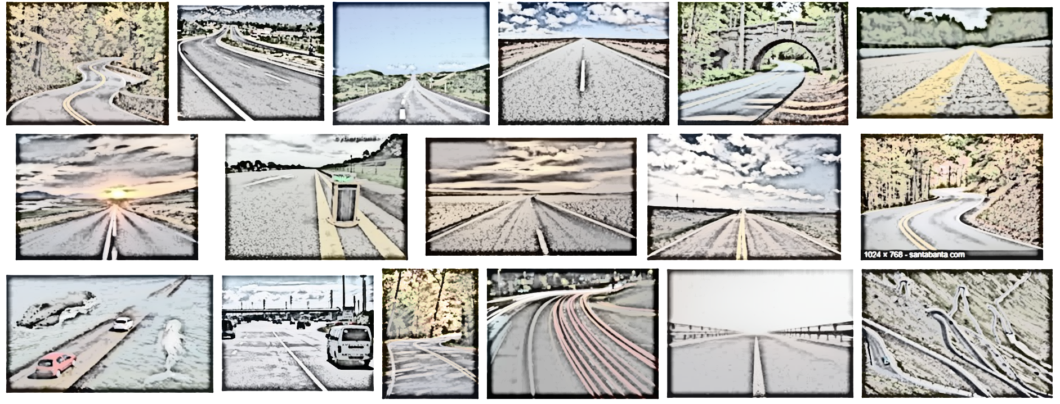


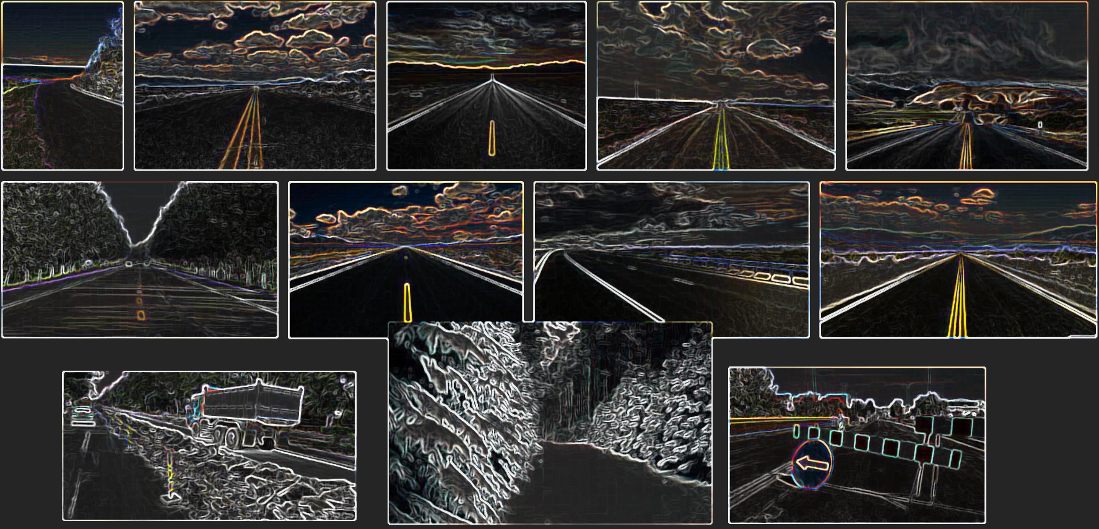
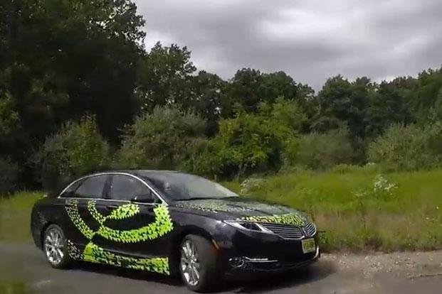
Big Data => Small ML Models
#devoxxma

Slide 21
Velocity
#devoxxma

Slide 22


Slide 23








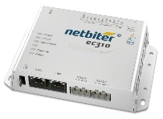
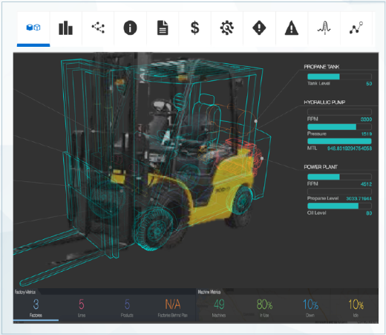

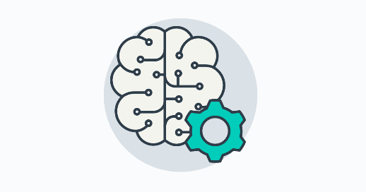

Fast Data – Fast Insight
Streaming with
Hot (Alerting) and Cold
IoT
Event Hub
Device Data
Digital Twin
Raw Data
Models to apply to digital twin to predict maintenance need
Machine Learning
#devoxxma

Slide 24
Data Volatility
Supplier
Customers
Desktop Browser
List of Products shown in UI
Recent Consumer purchases information
Gov Agency
Email / Facebook / WhatsApp
Mobile Devices
B2B APIs
DaaS Services
high
low
Personal Profile, Order and Payments Details
APIs
Data providers
Footage from security cameras
Weather, Demographics, Sports, Social, …
Offers, invoices, rewards messages
Mobile App
B2B APIs
Open Data APIs
Customer Service SaaS
WebShop Portal
B2B Partner Portal
API Gateway
Private Blockchain
Smart Contracts with supply chain details
Case files (Complaints, Requests)
Public Internet/External Actors
Readings from motion detectors
Audit Trails, Security Incidents
Shopping Cart with selected items
API usage, billing, policies
Running & Past workflow instances
Inside the Enterprise
User Stories, Designs, Discussions
IoT Gateways & Hub
Security & Compliance Monitor
Recommendation Engine
Human Workflow Engine
Communication & Collaboration tools
Inventory & Warehousing
Service Bus
Security
Order Management
Shipping
Digital Twin
Config data
Application Server
ML Models
Rule Engine
Application & Infrastructure source history
Mail Server
Custom Application for Product Catalog
Output (print & mail, email, SMS, …)
LDAP for Users, Roles & Permissions
Asset Tracker
Custom Order Management Application
Event Bus
In Flight Messages
Rules & Rule Execution metrics
Sales Aggregates by Day, Region, Product Category
Order Details
SaaS ERP
Enterprise Dashboard & BI & Reporting
Emails regarding customer complaints
Customer Details
Customer Management
KPIs & Alerts
Supplier & Product Management
Finance
Accounts, Invoices
Events
Invoices & Payments
Monitor for Application & Infra metrics
Source Code Control System
SaaS CRM
Job Scheduling
Event Bus
Data Warehouse
Desktop Tools
Job Schedules
Customer Interaction records
SaaS CX
Campaigns, Social Media Monitor, 360 Customer View
Spreadsheets with Sales records
Enterprise Content Management System
WebShop activity, Social Media discussions, …
Big Data Lake
Marketing & Campaigns
Data Department
Consolidation, MI, Reporting, Analysis and R&D
Programming in progress
Corporate Database
Logging Collector & Monitor & Analyzer
File Storage
Log-files from IT systems (infra & platform)
ML Models
Product Manuals

Slide 25
Demo – Cache
Application Container Cache
Cache
UI
API
Microservice ShoppingCart & Check Out
#devoxxma

Slide 26
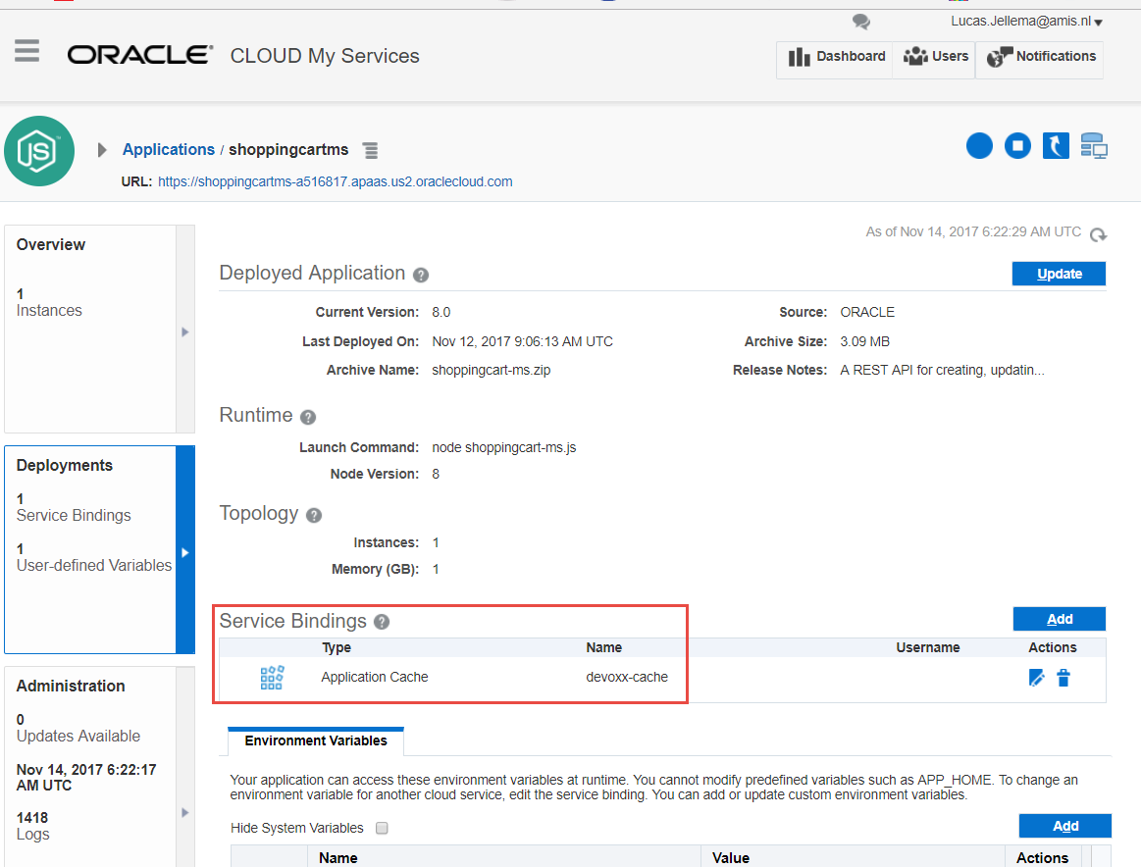
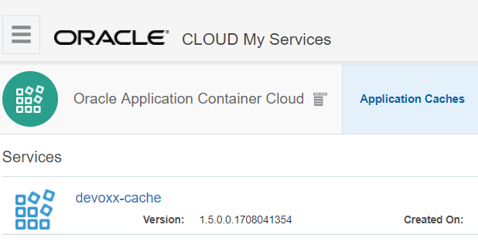
Oracle Cloud Microservice & Cache
Application Container Cache
Cache
UI
API
Microservice ShoppingCart & Check Out
#devoxxma

Slide 27
Location
#devoxxma

Slide 28
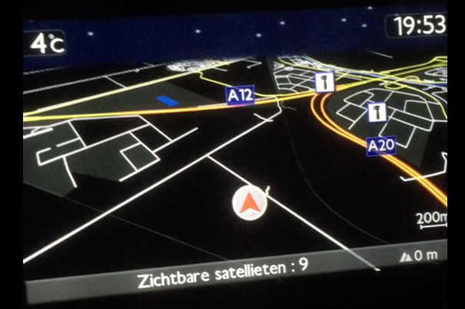
Location of Data
#devoxxma

Slide 29
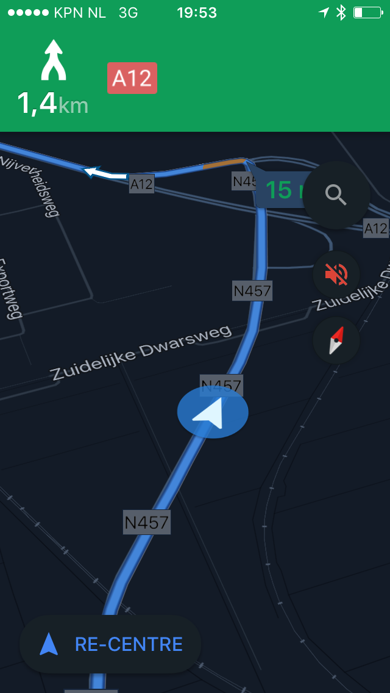
Location of Data
#devoxxma

Slide 30
Data Location
Supplier
Customers
Desktop Browser
Global Content Delivery Network
Recent Consumer purchases information
Gov Agency
Email / Facebook / WhatsApp
Mobile Devices
B2B APIs
DaaS Services
low
Offline Storage in Apps
APIs
Data providers
Footage from security cameras
Personal Profile, Order and Payments Details
Weather, Demographics, Sports, Social, …
Offers, invoices, rewards messages
Mobile App
DaaS data store in Cloud
B2B APIs
Open Data APIs
Customer Service SaaS
WebShop Portal
B2B Partner Portal
API Gateway
Private Blockchain
Smart Contracts with supply chain details
Case files (Complaints, Requests)
Public Internet/External Actors
Local storage on “Things” & Edge devices
API usage, billing, policies
Running & Past workflow instances
Inside the Enterprise
SaaS data store in Cloud
User Stories, Designs, Discussions
IoT Gateways & Hub
Security & Compliance Monitor
Recommendation Engine
Human Workflow Engine
Communication & Collaboration tools
Inventory & Warehousing
Service Bus
Security
Order Management
Shipping
Digital Twin
Config data
Application Server
ML Models
Rule Engine
Mail Server
Custom Application for Product Catalog
Output (print & mail, email, SMS, …)
LDAP for Users, Roles & Permissions
Asset Tracker
Custom Order Management Application
Event Bus
Rules & Rule Execution metrics
Order Details
SaaS ERP
Enterprise Dashboard & BI & Reporting
Emails regarding customer complaints
Application Server Memory (on site)
KPIs & Alerts
Supplier & Product Management
Excel Sheets on employee laptops
Customer Details
Customer Management
Finance
Accounts, Invoices
Monitor for Application & Infra metrics
Invoices & Payments
Source Code Control System
SaaS CRM
Job Scheduling
Event Bus
Data Warehouse
Desktop Tools
Local Database Instance for each region
Job Schedules
Customer Interaction records
SaaS CX
Campaigns, Social Media Monitor, 360 Customer View
Enterprise Content Management System
Big Data Lake
Marketing & Campaigns
Data Department
Consolidation, MI, Reporting, Analysis and R&D
Programming in progress
Corporate Database
Logging Collector & Monitor & Analyzer
Third party (SaaS) Git repo
Offsite Standby for Disaster Recovery
Cloud storage for Database backups
Log-files from IT systems (infra & platform)
File Storage
Product Manuals
ML Models

Slide 31
Considerations around Location
Latency
Latency experienced by end-user is sum of latencies in the chain
Co-located – systems with chatty interaction
Storage cost
Network Transport costs
Ease of distribution
Background distribution may be acceptable – provided it happens frequently enough
Off line usage
Security
Data “en route”
#devoxxma
Notes:
https://specify.io/concepts/microservices

Slide 32
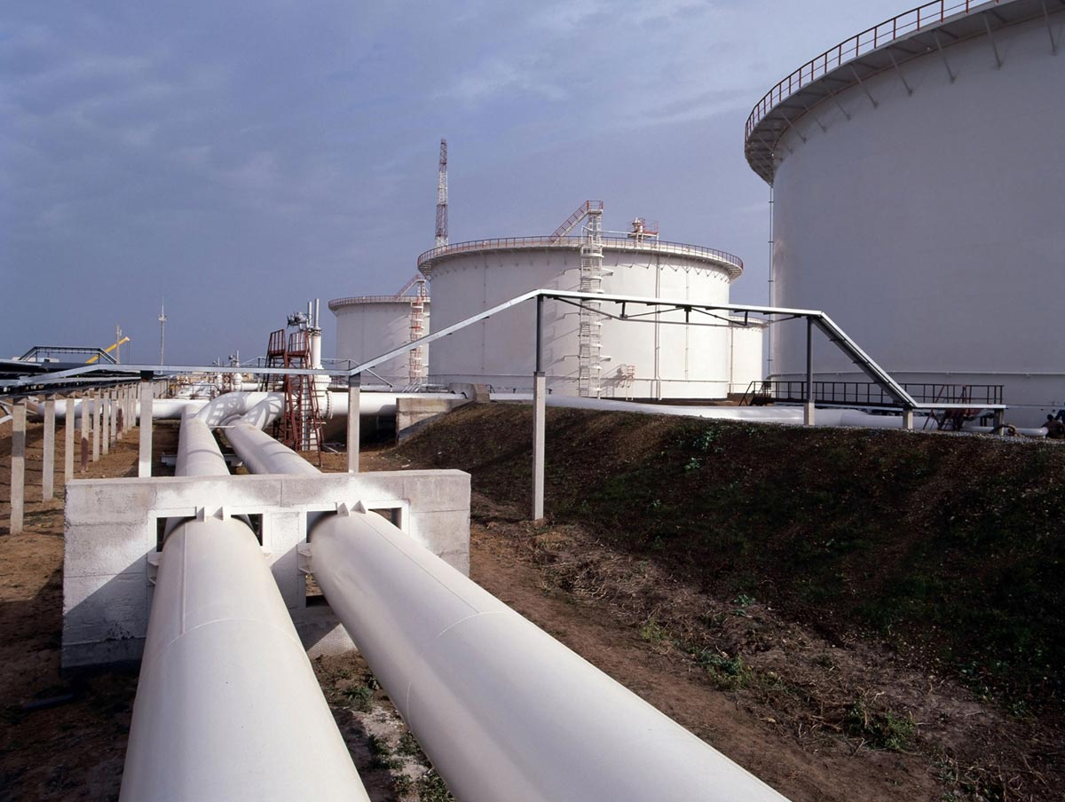
On the move
#devoxxma
Notes:
https://specify.io/concepts/microservices

Slide 33
Streaming
Supplier
Customers
Desktop Browser
Recent Consumer purchases information
Gov Agency
Email / Facebook / WhatsApp
Mobile Devices
B2B APIs
DaaS Services
low
Synchronization of Devices coming online again
APIs
Data providers
Footage from security cameras
Personal Profile, Order and Payments Details
Weather, Demographics, Sports, Social, …
Offers, invoices, rewards messages
Mobile App
B2B APIs
Open Data APIs
Customer Service SaaS
WebShop Portal
B2B Partner Portal
API Gateway
Private Blockchain
Smart Contracts with supply chain details
Case files (Complaints, Requests)
Task notification sent to employee
Public Internet/External Actors
Raw IoT => Streaming Analysis => {alerts | digital twin | big data}
UI updates pushed to browser
API usage, billing, policies
Running & Past workflow instances
Inside the Enterprise
User Stories, Designs, Discussions
IoT Gateways & Hub
Security & Compliance Monitor
Recommendation Engine
Human Workflow Engine
Communication & Collaboration tools
Inventory & Warehousing
Service Bus
Security
Order Management
Shipping
Fresh Data pushed to Application Cache
Rule Engine
Digital Twin
Config data
Application Server
ML Models
Mail Server
Custom Application for Product Catalog
Output (print & mail, email, SMS, …)
LDAP for Users, Roles & Permissions
Asset Tracker
Custom Order Management Application
Upload of ML Models
Event Bus
Rules & Rule Execution metrics
Synchronization of SaaS from On Premises
Order Details
SaaS ERP
Customer sending complaint by email
Applications being deployed
Enterprise Dashboard & BI & Reporting
Emails regarding customer complaints
Customer Management
KPIs & Alerts
Supplier & Product Management
Finance
Accounts, Invoices
Customer Details
Events moving to consumers
Monitor for Application & Infra metrics
Invoices & Payments
Source Code Control System
SaaS CRM
Job Scheduling
Update of Datawarehouse
Event Bus
Data Warehouse
Desktop Tools
Job Schedules
Customer Interaction records
Metrics from Apps | Platform | Infra to Log Stash & Monitor
Laptops & USB sticks on the move
SaaS CX
Campaigns, Social Media Monitor, 360 Customer View
Enterprise Content Management System
Big Data Lake
Marketing & Campaigns
Data Department
Consolidation, MI, Reporting, Analysis and R&D
Programming in progress
Corporate Database
Logging Collector & Monitor & Analyzer
Database Backup moved offsite
Replaying transaction on standby database
File Storage
Log-files from IT systems (infra & platform)
ML Models
Product Manuals

Slide 34
Cost
#devoxxma

Slide 35
TC(D)O – Total Cost of Data Ownership
Business cost (missed opportunity, user dissatisfaction, …) of not having the data available
at all or fast enough or fresh enough
Speed
Freshness
Available
Compute
Storage
Network
#devoxxma
Notes:
https://specify.io/concepts/microservices

Slide 36
TC(D)O – Total Cost of Data Ownership
Direct cost of
Acquiring data
Storing Data
Storage (cheap and slow, expensive and quick)
Compression (less storage at expense of compute)
Retrieving Data
Compute resources
Calculating & Deriving data (DWH, ML Model, CQRS)
Compute resources
Transporting Data
Network traffic has a price tag
#devoxxma
Notes:
https://specify.io/concepts/microservices

Slide 37
TC(D)O – Total Cost of Data Ownership
Operational costs
Backup & Recovery
Security
Intellectual property
Life cycle management – slower tier, archive, purge
“Right to be forgotten”
Regulatory periods to hang on to data
#devoxxma
Notes:
https://specify.io/concepts/microservices

Slide 38
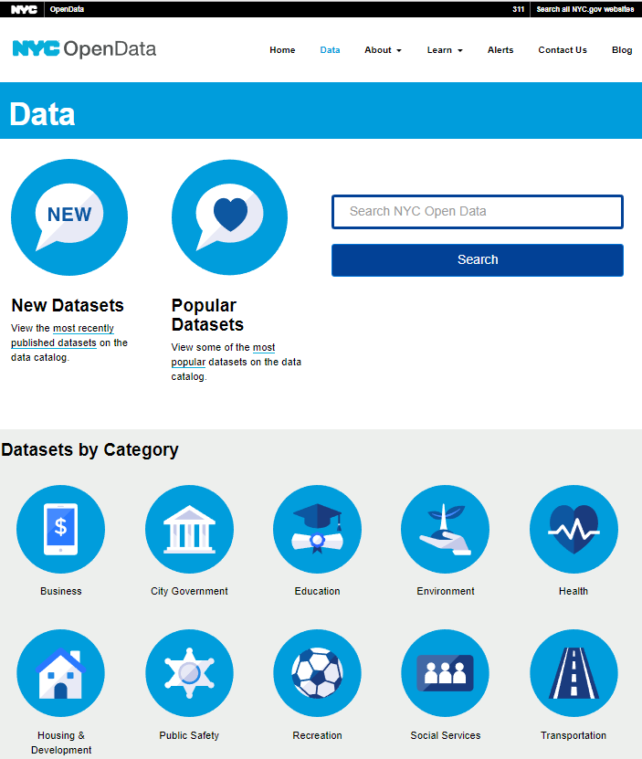

Open (APIs) & DaaS
Governments and NGOs, scientific and even commercial organizations are publishing data
Inviting anyone who wants to join in to help make sense of the data – understand driving factors, identify categories, help predict
Many areas
Economy, health, public safety, sports, traffic & transportation, games, environment, maps, …
#devoxxma
Notes:
http://morocco.opendataforafrica.org/

Slide 39
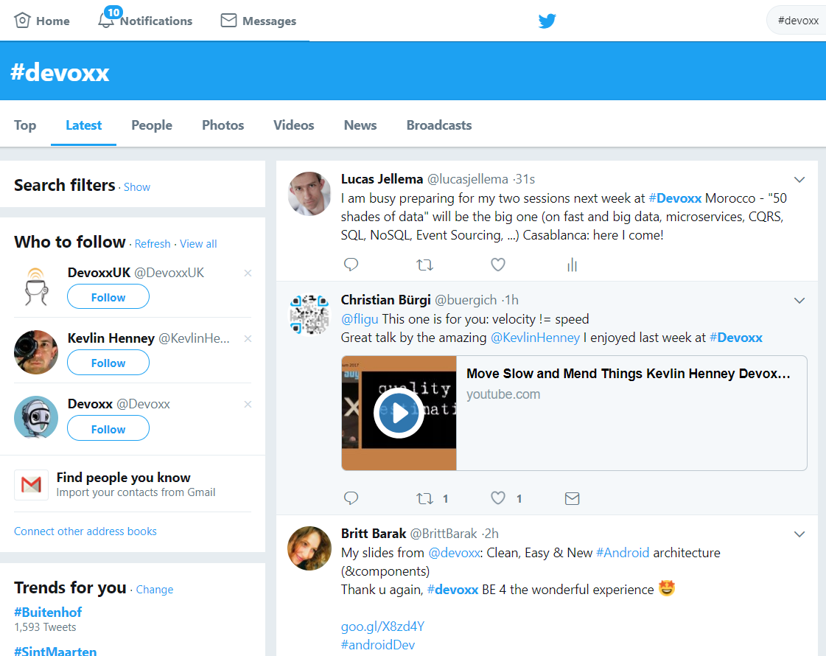
Live
#devoxxma
Notes:
https://specify.io/concepts/microservices

Slide 40



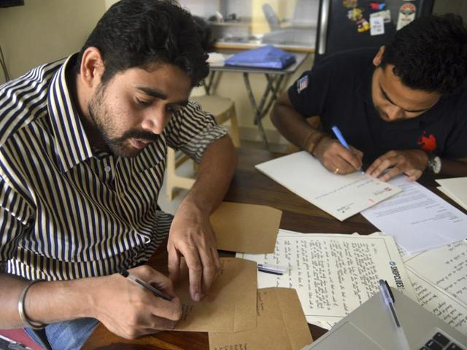
Real Life
BPM Engine
Processing cases for Customers
Background Batch Process
(preparing letters for customers)
Customers
#devoxxma
Notes:
https://specify.io/concepts/microservices

Slide 41
Stale
#devoxxma

Slide 42
Stale
Data is a representation of the real world
All data is inherently stale
Except when it describes something that can not change – and whose description can not change
Staleness is probably not a problem
Except in self driving cars…
Run the end-of-year-report
Consistency is much more important
#devoxxma

Slide 43
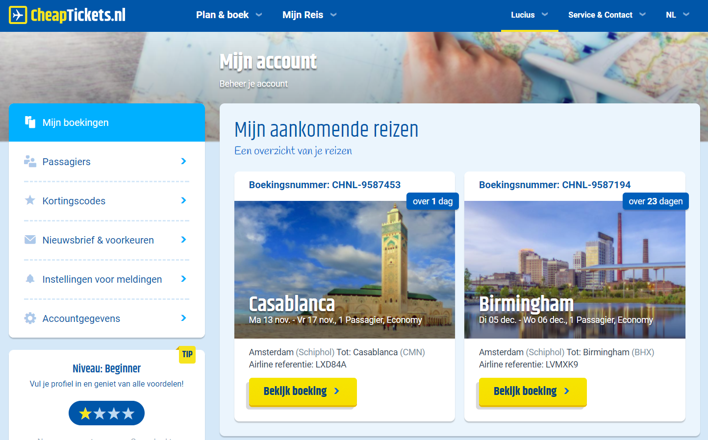
Benefitting from staleness
#devoxxma
Notes:
https://specify.io/concepts/microservices

Slide 44
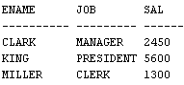
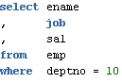
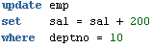
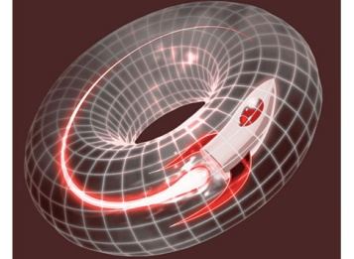
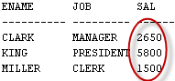
Glimpses of the past
Session 1
Session 2
#devoxxma
Notes:
https://specify.io/concepts/microservices

Slide 45
Glimpses of the past
Session 1
Session 2
#devoxxma
Notes:
https://specify.io/concepts/microservices

Slide 46
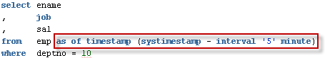
Flashback to the Past
#devoxxma
Notes:
https://specify.io/concepts/microservices

Slide 47
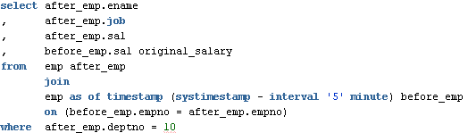
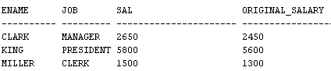
Compare now with the past
#devoxxma
Notes:
https://specify.io/concepts/microservices

Slide 48
Powered by Undo
UNDO
#devoxxma
Notes:
https://specify.io/concepts/microservices

Slide 49
Integrity
#devoxxma

Slide 50

Data Constraints to protect integrity
Allowable values
Mandatory attributes
(Foreign Key) References
NULL
Constraints on
type
length
format
Spelling
Character encoding
#devoxxma
Notes:
https://specify.io/concepts/microservices

Slide 51


Data is representation of the known real world
How useful is it to enforce data integrity?
#devoxxma
Notes:
https://specify.io/concepts/microservices

Slide 52

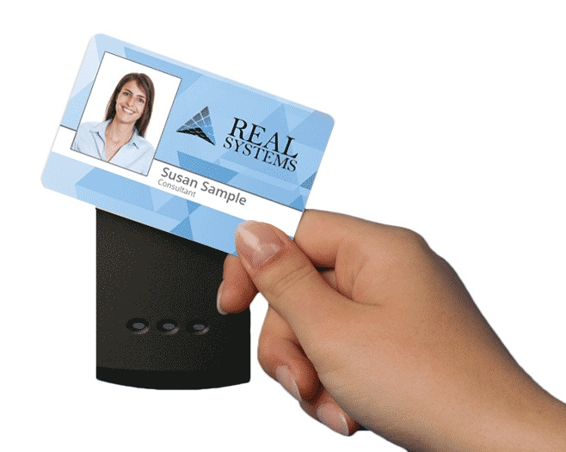



Virtual Reality
#devoxxma
Notes:
https://specify.io/concepts/microservices

Slide 53

Data Integrity
Why?
Is it about truth?
About regulations and by-the-book?
Allow IT systems to run smoothly and not get confused?
About auditability and non-repudiation?
What about the real world?
Data in IT is just a representation; if the world is not by the book – what should IT do?
#devoxxma
Notes:
https://specify.io/concepts/microservices

Slide 54
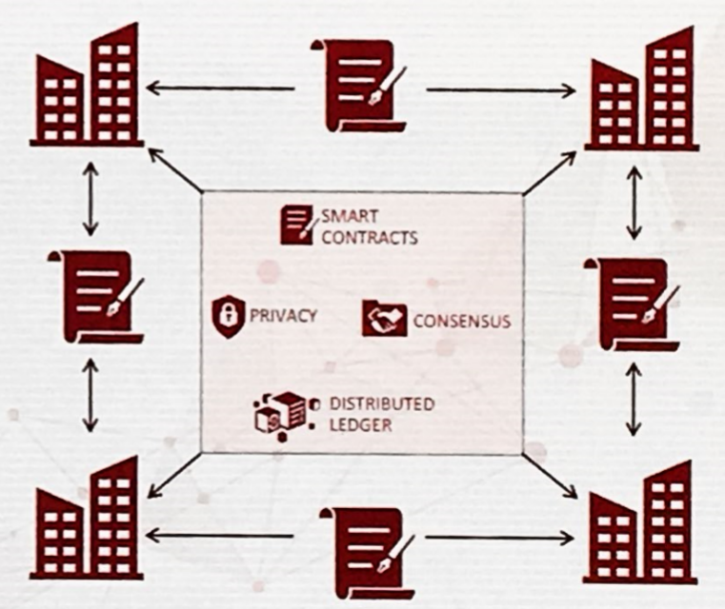
Blockchain
Distributed
Across trusted business partners
Across public, anonymous parties
Immutable
Secured
Smart Contracts
Operations on data (without human intervention)
#devoxxma
Notes:
https://specify.io/concepts/microservices

Slide 55
Format & Technology
#devoxxma

Slide 56
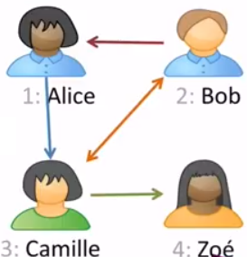
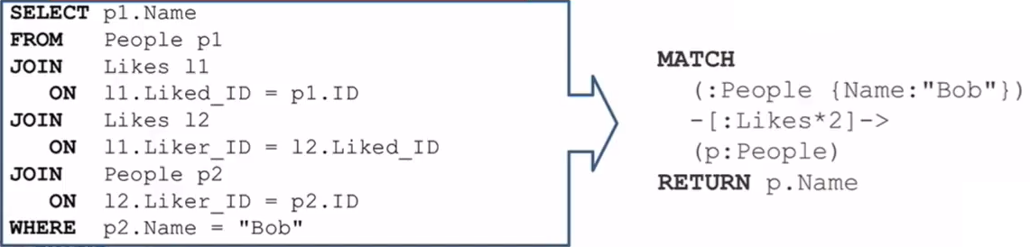
Graph Database
Natural fit during development
Superior (10-1000 times better) performance
#devoxxma
Notes:
https://specify.io/concepts/microservices

Slide 57
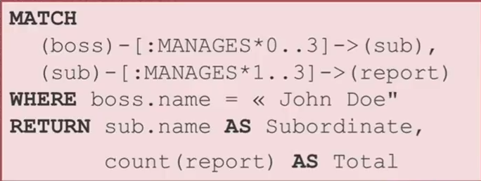
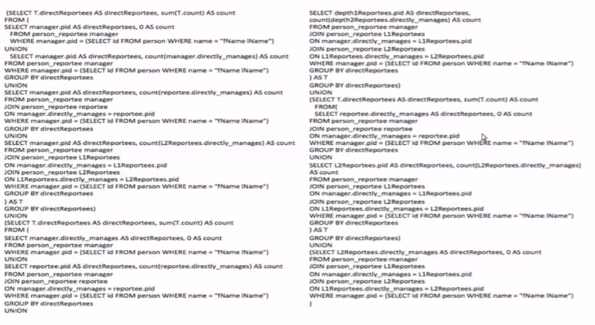
From relational SQL to Graph query
#devoxxma
Notes:
https://specify.io/concepts/microservices

Slide 58
SQL vs NoSQL
#devoxxma

Slide 59
SQL vs NoSQL ACID vs BASE Relational vs …
#devoxxma

Slide 60

SQL is not good at anything
But it sucks at nothing
#devoxxma
Notes:
https://specify.io/concepts/microservices

Slide 61
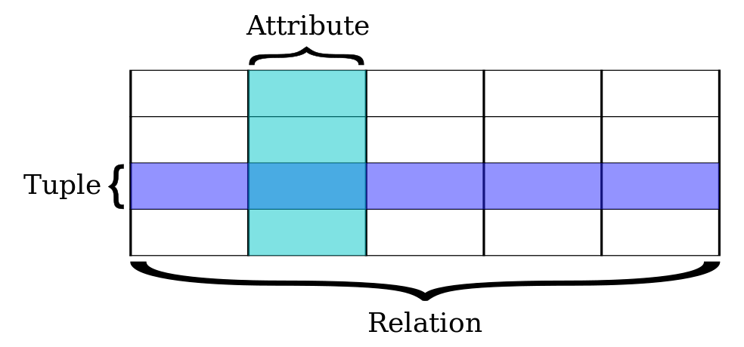
Relational Databases
Based on relational model of data (E.F. Codd), a mathematical foundation
Uses SQL for query, DML and DDL
Transactions are ACID (Atomicity, Consistency, Isolation, Durability)
All or nothing
Constraint Compliant
Individual experience [in a multi-session environment] (aka concurrency)
Down does not hurt
#devoxxma
Notes:
https://specify.io/concepts/microservices

Slide 62
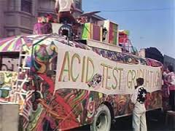
ACID comes at a cost
Transaction results have to be persisted in order to guarantee D
Concurrency requires some degree of locking (and multi-versioning) in order to have I
Constraint compliance (unique key, foreign key) means all data hangs together (as do all transactions) in order to have C
Two-phase commit further introduces complexity, dependencies and delays
#devoxxma
Notes:
https://specify.io/concepts/microservices

Slide 63

The holy grail of Normalization
Normalize to prevent
data redundancy
discrepancies (split brain)
storage waste
However: we should recognize the fact that some data is read far more frequently than that it is created and modified
#devoxxma
Notes:
https://specify.io/concepts/microservices

Slide 64
The Relational Model in practice
Traditional Relational Data Model has severe impact on physical disk performance
Transaction Log => Sequential Write (append to file)
Data Blocks require much more expensive Random Access disk writes
Indexes (B-Tree, Bitmap, …) are used to speed up query (read) performance
and slow down transactions
Relational data does not [always] map naturally to the data format required in the application (OO, JSON, XML)
Capability to join and construct ad-hoc queries across the entire data model is powerful
Declarative integrity constraints allow for strict enforcement of data quality rules
“the data may be non sensical, but at least it adheres to the rules”
#devoxxma
Notes:
https://specify.io/concepts/microservices

Slide 65
Databases re-evaluated
Not all use cases require ACID (or can afford it)
Read only (product catalog for web shops)
Inserts only and no (inter-record) constraints
Big Data collected and “dumped” in Data Lake (Hadoop) for subsequent processing
High performance demands
Not all data needs structured formats or structured querying and JOINs
Entire documents are stored and retrieved based on a single key
Sometimes – scalable availability and productivity is more important than Consistency – and ACID is sacrificed
CAP-theorem states: Consistency [across nodes], Availability and Partition tolerance can not all three be satisfied
#devoxxma
Notes:
https://specify.io/concepts/microservices

Slide 66
NoSQL and BASE
NoSQL arose because of performance and scalability challenges with Web Scale operations
NoSQL is a label for a wide variety of databases that lack some aspect of a true relational database
ACID-ness, SQL, relational model, constraints
The label has been used since 2009
Perhaps NoREL would be more appropriate
Some well known NoSQL products are
Cassandra, MongoDB, Redis, CouchDB, …
BASE as alternative to ACID:
basically available, soft state, eventually consistent (after a short duration)
#devoxxma
Notes:
https://specify.io/concepts/microservices

Slide 67
Typical for NoSQL
Focus on speed, availability and scalability
Horizontal scale out – distributed with load balancing and fail-over
No (predefined) Data Structure
Integrity primarily protected by application logic
Open Source (most offerings are, not all: MarkLogic)
Close(r) attention for how the data is used
Application oriented data format and search paths and specialized database per application (microservice, capability)
Similar to the switch from SOA to API/Microservice
Reads (far) more relevant than writes
Data redundancy & denormalization
No data access through SQL – well, …
#devoxxma
Notes:
https://specify.io/concepts/microservices

Slide 68




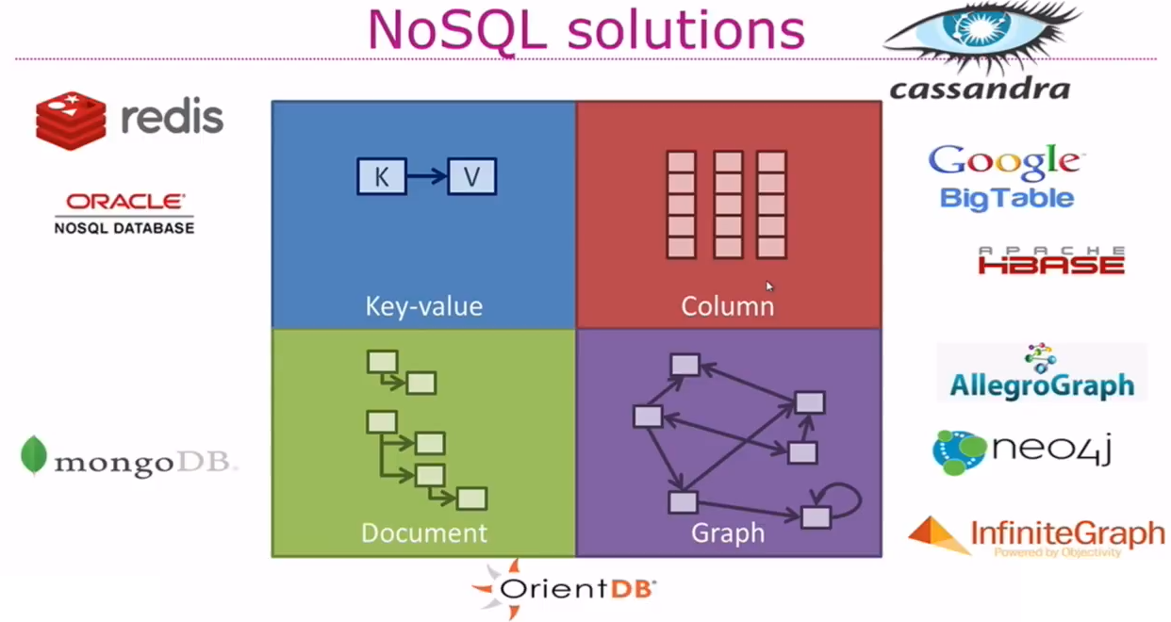




Types of NoSQL
#devoxxma
Notes:
https://specify.io/concepts/microservices

Slide 69
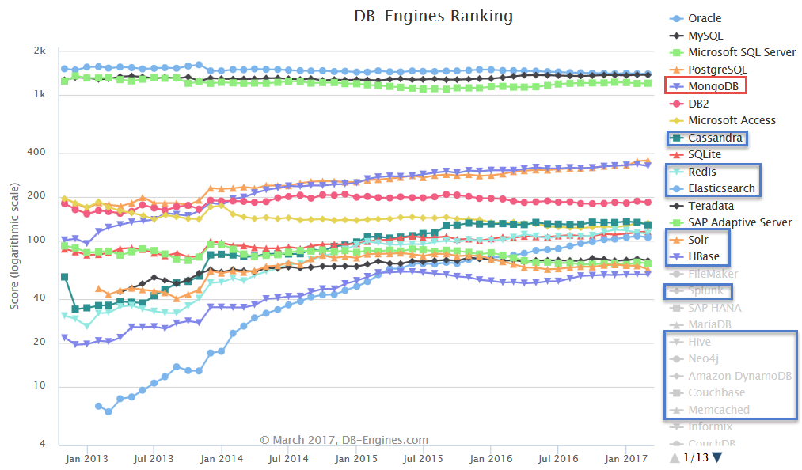
(leading) NoSQL Database products
MongoDB is (one of) the most popular (by any measure)
Cloud (only):
Google BigTable,
AWS Dynamo
Cache (in memory)
ZooKeeper, Redis, Memcached, …
Hadoop/HDFS
Oracle NoSQL (fka Berkeley DB)
#devoxxma
Notes:
https://specify.io/concepts/microservices

Slide 70
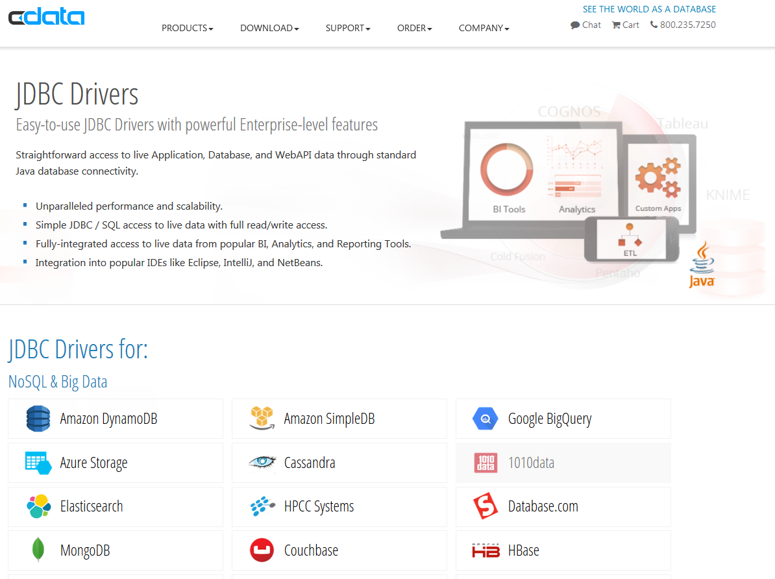
NoSQL means: No Data Access through SQL
However
Data Professionals and Developers speak SQL
Reporting, Dashboarding, ETL, BI tools speak SQL
There is no common query language across NoSQL products
#devoxxma
Notes:
https://specify.io/concepts/microservices

Slide 71

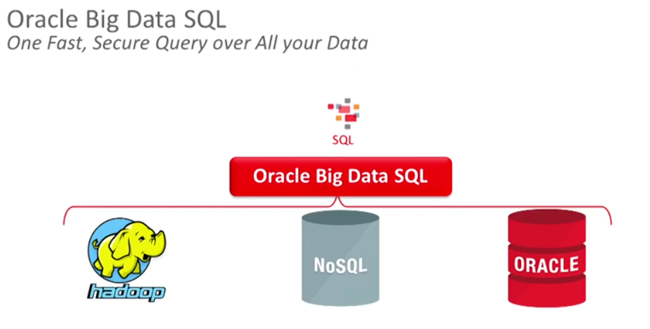
No Data Access through SQL
However
Data Professionals and Developers speak SQL
Reporting, Dashboarding, ETL, BI tools speak SQL
There is no common query language across NoSQL products
Attempts from many vendors to create drivers that translate SQL statements into NoSQL commands for the specific target database
To protect existing investments in SQL – skills, tools, applications, reports, ..
#devoxxma
Notes:
https://specify.io/concepts/microservices

Slide 72
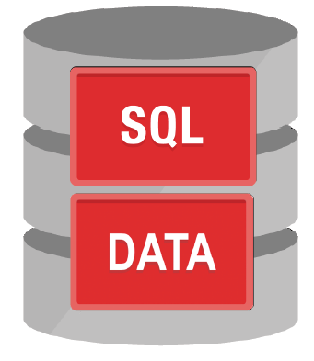
SQL vs NoSQL
SQL != RDBMS
SQL on top of
Hadoop – Spark SQL, Hive, Drill, Impala
“External Table” Text files, CSV, Excel
XML, JSON
KSQL on Kafka events
Google Spanner, BigQuery
NoSQL – Berkeley DB, Hbase, Elastic Search, MongoDB, Cassandra
#devoxxma
Notes:
https://specify.io/concepts/microservices

Slide 73

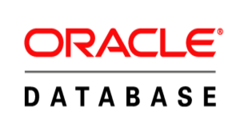
NoSQL (MongoDB) vs SQL (Oracle)
db.emp.find ( {"JOB":"SALESMAN"} , { ENAME:1 , SAL:1} ) .sort ( {'SAL':-1}) .limit(2)
select ename , sal
from emp
where job = 'SALESMAN'
order
by sal desc FETCH FIRST 2 ROWS ONLY
#devoxxma

Slide 74
NoSQL (MongoDB) vs SQL (Oracle)
db.emp.find
( {"JOB":"SALESMAN" , $where : " this.SAL + (this.COMM != null? this.COMM: 0) > 2000"
}
)
select *
from emp
where sal + nvl(comm, 0) > 2000
#devoxxma

Slide 75
Distributed
#devoxxma

Slide 76
Why distributed?
Because it is
Business is physically spread out over multiple locations
To achieve
Scalability
Performance (parallelism, latency)
Resilience of the whole – availability (in the face of individual failure)
(site) Disaster recovery
Trust (e.g. blockchain)
Applies to data & processes
#devoxxma
Notes:
https://specify.io/concepts/microservices

Slide 77
Distributed
Supplier
Customers
Desktop Browser
Global Content Delivery Network
Recent Consumer purchases information
Gov Agency
Email / Facebook / WhatsApp
Mobile Devices
B2B APIs
DaaS Services
low
Offline Storage in Apps
APIs
Data providers
Footage from security cameras
Personal Profile, Order and Payments Details
Weather, Demographics, Sports, Social, …
Offers, invoices, rewards messages
Mobile App
B2B APIs
Open Data APIs
Customer Service SaaS
WebShop Portal
B2B Partner Portal
API Gateway
Private Blockchain
Smart Contracts with supply chain details
Case files (Complaints, Requests)
Distributed Event Bus: Kafka
Public Internet/External Actors
Local storage on “Things” & Edge devices
API usage, billing, policies
Running & Past workflow instances
Inside the Enterprise
Distributed In Memory Cache Hazelcast, MemCached, Redis, Coherence
User Stories, Designs, Discussions
IoT Gateways & Hub
Security & Compliance Monitor
Recommendation Engine
Human Workflow Engine
Communication & Collaboration tools
Inventory & Warehousing
Service Bus
Kubernetes Distributed Container Platform
Security
Order Management
Shipping
Multiple sites around the globe with local …
Config data
Rule Engine
Digital Twin
Application Server
ML Models
Mail Server
Distributed Datastore MongoDB, Cassandra, BigTable, HBase
Output (print & mail, email, SMS, …)
LDAP for Users, Roles & Permissions
Asset Tracker
Custom Order Management Application
Custom Application for Product Catalog
Java EE Application Server Cluster
Event Bus
Rules & Rule Execution metrics
Order Details
SaaS ERP
Enterprise Dashboard & BI & Reporting
Emails regarding customer complaints
Logical Data Shards in Oracle Database, MySQL, Elastic
Customer Details
Customer Management
KPIs & Alerts
Supplier & Product Management
Finance
Accounts, Invoices
Monitor for Application & Infra metrics
Invoices & Payments
SETI
Source Code Control System
SaaS CRM
Job Scheduling
Apache Spark Distributed Data Processing
Event Bus
Desktop Tools
Data Warehouse
Job Schedules
HDFS Hadoop Distributed File System
Customer Interaction records
SaaS CX
Campaigns, Social Media Monitor, 360 Customer View
Real Application Clusters
Enterprise Content Management System
SAN
Marketing & Campaigns
Data Department
Consolidation, MI, Reporting, Analysis and R&D
Big Data Lake
Programming in progress
Corporate Database
Logging Collector & Monitor & Analyzer
Cross Cloud/On Premises archive
File Storage
Log-files from IT systems (infra & platform)
Active Standby Database
Product Manuals
ML Models

Slide 78

Vertically Distributed Data
Client Tier: Browser
DOM/UI
MVVM
API
API
Stateless
API
Middle Tier:
Java EE (Stateful) application
#devoxxma
Notes:
https://specify.io/concepts/microservices

Slide 79

Vertically Distributed Data
Client Tier: Browser
DOM/UI
MVVM
API
API
Stateless
API
Middle Tier:
Java EE (Stateful) application
#devoxxma
Notes:
https://specify.io/concepts/microservices

Slide 80
Availability
#devoxxma

Slide 81
Availability
Supplier
Customers
Desktop Browser
Global Content Delivery Network
Recent Consumer purchases information
Gov Agency
Email / Facebook / WhatsApp
Mobile Devices
B2B APIs
DaaS Services
H/A for IoT Hub
Webshop 24/7 on line
APIs
Data providers
Footage from security cameras
low
Personal Profile, Order and Payments Details
Weather, Demographics, Sports, Social, …
Offers, invoices, rewards messages
Mobile App
B2B APIs
Open Data APIs
Fairly high availability for [clusters of] things – not for individual things
Smart Contracts with supply chain details
Customer Service SaaS
WebShop Portal
B2B Partner Portal
API Gateway
Private Blockchain
Case files (Complaints, Requests)
Some loss or service is acceptable for recommendation engine
Public Internet/External Actors
API usage, billing, policies
Running & Past workflow instances
Inside the Enterprise
Fairly high availability for [clusters of] things – not for individual things
Service Bus 24/7 on line
User Stories, Designs, Discussions
Security & Compliance Monitor
Recommendation Engine
Human Workflow Engine
Communication & Collaboration tools
IoT Gateways & Hub
H/A during extended office hours for human workflow engine
Inventory & Warehousing
Service Bus
Security
Order Management
Shipping
Digital Twin
Config data
Application Server
ML Models
Rule Engine
Mail Server
Custom Application for Product Catalog
EventBus 24/7 on line
Output (print & mail, email, SMS, …)
LDAP for Users, Roles & Permissions
Asset Tracker
Custom Order Management Application
SaaS CRM less available than desired
Event Bus
Rules & Rule Execution metrics
Order Details
SaaS ERP
Enterprise Dashboard & BI & Reporting
Emails regarding customer complaints
KPIs & Alerts
H/A for Oracle Database
Customer Details
Customer Management
Supplier & Product Management
Finance
Accounts, Invoices
Monitor for Application & Infra metrics
Invoices & Payments
Relaxed availability (office hours) for DWH
Source Code Control System
SaaS CRM
Job Scheduling
H/A for LDAP
Low availability demands on Big Data
Event Bus
Data Warehouse
Desktop Tools
Job Schedules
Customer Interaction records
SaaS CX
Campaigns, Social Media Monitor, 360 Customer View
Enterprise Content Management System
SAN
Marketing & Campaigns
Data Department
Consolidation, MI, Reporting, Analysis and R&D
Big Data Lake
Programming in progress
Corporate Database
Logging Collector & Monitor & Analyzer
Cross Cloud/On Premises archive
File Storage
Log-files from IT systems (infra & platform)
Active Standby Database
Product Manuals
ML Models

Slide 82
Availability of Data
Availability:
unplanned downtime (incident => disaster)
planned (not desired) downtime (upgrade, patch to application, platform, infra)
Chain is as strong as the weakest link
Availability is determined by least available component
Datastore can drive (and help improve) availability of many systems/applications/services
Custom UI on top of SAP requires 99.95% up time – SAP only offers 98%
Increase availability
H/A architecture – multi-node cluster, hot standby and fail-over, disaster recovery
Rolling upgrades
Single node for command, multiple (independent) helpers for query
#devoxxma
Notes:
https://specify.io/concepts/microservices

Slide 83
Case of Web Shop
Webshop – 1M visitors per day
Product catalog consists of 15+ millions of records
The web shop presents: product description, images, reviews, pricing details, related offerings, stock status
Some Products are added and updated and removed every day
Although most products do not change very frequently
Some vendors do bulk manipulation of product details
Webshop visits
searches
product details
orders
Products
Product updates
#devoxxma

Slide 84
Case of Web Shop – Usage Patterns & Architecture
Webshop visits
searches
product details
orders
Products
Product updates
Read only
On line
Speed is crucial
XHTML & JSON
> 5M visits
Data manipulation
Data Quality (enforcement)
<10K transactions
Batch jobs next to online
Speed is nice
firewall
#devoxxma

Slide 85

Case of Web Shop – Technology and Architecture
Nightly generation
DMZ
Webshop visits
searches
product details
orders
Products
Products
Products
Products
Product updates
Read only
On line
Speed is crucial
XHTML & JSON
> 1M visits
Read only
JSON documents
Images
Text Search
Scale Horizontally
Stale but consistent
Data manipulation
Data Quality (enforcement)
<10K transactions
Batch jobs next to online
Speed is nice
#devoxxma
firewall

Slide 86
CQRS
#devoxxma

Slide 87
CQRS - Command and Query Responsibility Segragation
Products
Data Manipulation
Special Products
Quick Product Search Index
Data Retrieval
Toys
Product Clusters
Food Stuff
#devoxxma

Slide 88
CQRS in Oracle Database
Middleware
Middleware
Middleware
Active Data Guard Standby
Shard
(12c R2)
IMDB
Shard
(12c R2)
SGA
RAC
MV
MV
RAC
SAN
T
T
idx
idx
SAN
SAN
Redo Logs
dbf
#devoxxma

Slide 89

CQRS - Command and Query Responsibility Segragation
Data manipulation and retrieval in separate places
(physical data proliferation)
Query store is optimized for consumers
Level of detail, format, filters applied
For performance and scalability, independence, productivity lower license fees and lower TCO, security
#devoxxma

Slide 90
Synchronizing the Query Stores
Products
Data Manipulation
Special Products
Quick Product Search Index
Data Retrieval
Toys
Product Clusters
Food Stuff
Product Store in SaaS app
#devoxxma

Slide 91
Synchronizing the Query Stores
Depends on
Freshness requirements
Authorization demands
Cost of synchronizing the query store (full synchronize vs event based)
Usage pattern for query store
Facilities available in Command store (and in query stores)
Relative locations (e.g. cloud & on premises)
Mechanisms
Importing Database dump-file (periodic, full or partial)
Direct queries & DML
Change Data Capture from transaction logs
Event based
#devoxxma

Slide 92
Event Sourcing
#devoxxma
Notes:
https://www.infoq.com/articles/microservices-aggregates-events-cqrs-part-1-richardson
http://microservices.io/patterns/data/event-sourcing.html
http://blog.kontena.io/event-sourcing-microservices-with-kafka/
https://specify.io/concepts/microservices
CQRS and Event Sourcing Applications with Cassandra - https://www.youtube.com/watch?v=3t8EUDiPfMQ
Martin Fowler - https://www.youtube.com/watch?v=aweV9FLTZkU
https://youtu.be/9a1PqwFrMP0?t=14m28s – Hospital – admit, transfer,transfer, discharge
Greg Young - https://www.youtube.com/watch?v=kZL41SMXWdM

Slide 93

State is sum of changes
Source: https://ookami86.github.io/event-sourcing-in-practice/#how-eventsourcing-works
#devoxxma
Notes:
https://ookami86.github.io/event-sourcing-in-practice/#how-eventsourcing-works

Slide 94
Take the UD out of CRUD
Bank Account Change Event
Event Type
Timestamp
Account Id
Amount
(New value for) Owner
Erased: some attribute
Introducing the Immu Table
A ledger of entity changes
With a timestamp or event sequence
And the entity identifier
And the new values of the added, changed, erased attributes
Each event is an immutable record that is appended to the ledger – just simply added to the end
Atomic, very cheap compared to Update and Delete – does not require a lock - it does require random file access and rearranging blocks on disk
#devoxxma

Slide 95
Event Log in Event Sourcing
Primary Data Source is ledger of change events
Not a store of the current state
However: optionally use snapshots of baseline (state up until time)
Entity Event Store replaces Table
Offers a simple API for creating and retrieving events
‘Entity Change Event’ Producer (to which consumers can subscribe)
To correct a mistake:
Do not remove the event! (it happened, it may already have been distributed)
Instead, create a compensating event (and then it unhappened)
#devoxxma

Slide 96

Event Log
Audit Log
Time travel
Reconstruct system (application state)
Distributed application state
Support multiple (read) models
Easy construct debugging environment – of exact situation and time
What-if scenarios –take copy, inject event & play forward from there
State = sum of change events
State = snapshot plus sum of recent events
To synch application state = current state + sum of events after the event version number on which current state is based
#devoxxma

Slide 97

To implement Event Sourcing
Take a data store
That is distributed, scalable, available
For example Apache Cassandra
Create an Event Log table for each business entity
Create columns for timestamp, event id, change type, entity identifier
Create columns for all attributes or a single column to hold a document (e.g. JSON)
A special change type can be ‘snapshot’ to specify a baseline
No older entries are needed in the event log
#devoxxma

Slide 98

Event Sourcing driving CQRS
#devoxxma

Slide 99
Microservices & Data
#devoxxma

Slide 100
What is IT all about?
Production Runtime
Application
#devoxxma

Slide 101
What is IT all about?
Production Runtime
Application
Platform
#devoxxma

Slide 102
What is IT all about?
Production Runtime
Operations
Monitoring & Management
Application
Platform
#devoxxma

Slide 103
One team has Agile responsibility through full lifecyle
Preparation Runtime
Production Runtime
Development
Operations
Monitoring & Management
Application
Application
Agile Design, Build, Test
Platform
Platform
CD
#devoxxma

Slide 104
One team has Agile responsibility through full lifecyle
Preparation Runtime
Production Runtime
DevOps
Development
Operations
Monitoring & Management
Application
Application
Agile Design, Build, Test
Platform
Platform
CD
You build it, you run it, you fix it, you evolve
#devoxxma

Slide 105
One team has Agile responsibility through full lifecyle
DevOps
Application
Application
Platform
Platform
You build it, you run it, you fix it, you evolve
#devoxxma

Slide 106
DevOps team owns and runs one (or more) products
Application
Platform
Generic Infrastructure Platform for running DevOps Products
Floorspace, Power, Cooling, Storage, Compute
Monitoring, Management, Cache, Authentication, RDBMS, Event Hub
#devoxxma

Slide 107
Multiple products from multiple teams run on a shared generic infrastructure
Application
Application
Application
Application
Application
Platform
Platform
Platform
Platform
Platform
Generic Infrastructure Platform for running DevOps Products
Floorspace, Power, Cooling, Storage, Compute
Monitoring, Management, Cache, Authentication, RDBMS, Event Hub
#devoxxma

Slide 108
App plus platform under DevOps == Microservice
µ
µ
µ
µ
µ
Generic Infrastructure Platform for running DevOps Products

Slide 109
App plus platform under DevOps == Microservice
Stateless
Horizontally scalable
Mutually Independent
upgrade, patch, relocate
Can expose Public API (HTTP/REST) and/or UI
Communicate with each other through events
Have their own bounded data context
Do not rely on other microservices [for the data they need]
Serverless – do not require allocated server, can be fired up
µ
µ
µ
µ
µ
Generic Infrastructure Platform for running DevOps Products

Slide 110
Microservices - objectives
How do we get from a Monolith to Microservices?
Minimize cost of change
Maximize agility
Isolate responsibility
Reduce cohesion by minimizing dependencies
logical, technical and runtime
only standardized communication/interaction
Independent, scalable processes
Choreograhy (broadcast) preferred over Orchestration (direct call)
Efficient operations
Comprehendable, controllable IT
#devoxxma
Notes:
https://specify.io/concepts/microservices

Slide 111
Data in microservices
Microservices are stateless & horizontally scalable
Microservices are isolated & independent
Where is their data?
What about lookup data?
Data not owned by the microservice – but still required by it to perform its role => bounded context
#devoxxma

Slide 112
Microservices State
Generic Platform for running microservices
LDAP
Big Data
Block Storage
Cache
RDBMS
NoSQL
Document Store
Event Hub
#devoxxma
Notes:
All data stores are distributed
Or at least distributedly available
They can be local or on cloud (latency is important)
Data in generic data store is still owned by only one microservice – no one can touch it
Only in DWH and BigData do we deliberately take copies of data and disown them

Slide 113
Bounded context in microservices
Micoservice needs to be able to run independently
It needs to contain & own all data required to run
It cannot depend on other microservices
UI
API
Customer
API
Order
CustomerModified event
#devoxxma

Slide 114
Canonical Model & [Business] Event Catalog
Events are life blood
How to do define event [payload]?
XML? JSON? Avro?
Publish event definitions in a corporate catalog
With clear description and examples
How to govern definition?
Changes that are backwards compatible: upcast (any instance of a new version of an event type is at least an older version)
Include a reference to the event type version in events
Note: when history & current state is reconstructed from events – some attributes may not be available
#devoxxma

Slide 115
Transactions across microservices
Do they event exist?
(synchronous) Two Phase Commit => SAGAs (workflow)
Status of record reflects ‘distributed transaction’
Order first pending and then either approved or rejected
Availability over Consistency (CAP theorem)
How to implement?
#devoxxma

Slide 116
Demo Microservices, CQRS & Events
#devoxxma

Slide 117
Demo – Shopping Cart & Order microservices plus state
Application Container Cache
Cache
RDBMS
UI
API
Oracle Database Cloud
UI
API
ShoppingCart & Check Out
Order
#devoxxma

Slide 118
Demo – Checking Out Cart => create order & publish event
Oracle Application Container Cache
Cache
RDBMS
Oracle Database Cloud
UI
API
UI
API
EventHub
Oracle Event Hub Cloud
ShoppingCart & Check Out
Order
NewOrder event
#devoxxma

Slide 119

Demo – Workflow to Evaluate New Order
Workflow Launcher
Check Total
Check Shipping
Event Bus
Judge Order
API
API
API
Cache
#devoxxma

Slide 120









Demo –Workflow Implementation - Docker Containers on Kubernetes
Workflow Launcher
Check Order Total
Check Shipping
Order Arbiter
Cache
Cache Inspector
LogMonitor
Event Bus
#devoxxma

Slide 121
Demo – Workflow triggered by NewOrder event
EventHub
Event Hub Cloud
NewOrder event
EventBridge
Workflow Launcher
Check Total
Check Shipping
Event Bus
Judge Order
NewOrder event
API
API
API
Cache
#devoxxma

Slide 122
Demo
Application Container Cache
Cache
RDBMS
UI
API
Database Cloud
EventHub
UI
API
Event Hub Cloud
ShoppingCart & Check Out
Order
EventBridge
Workflow Launcher
Check Total
Check Shipping
Event Bus
Judge Order
API
API
API
Cache
#devoxxma

Slide 123

Demo
Application Container Cache
Cache
RDBMS
UI
API
Database Cloud
UI
API
EventHub
Event Hub Cloud
ShoppingCart & Check Out
Order
EventBridge
Workflow Launcher
Check Order Total
Check Shipping
Order Arbiter
Cache
Cache Inspector
LogMonitor
Event Bus
#devoxxma

Slide 124

Demo
Application Container Cache
Cache
RDBMS
UI
API
Database Cloud
EventHub
UI
API
Event Hub Cloud
ShoppingCart & Check Out
Order
EventBridge
Customer
Workflow Launcher
Check Total
Check Shipping
Event Bus
API
Judge Order
API
API
API
Cache
#devoxxma

Slide 125
Demo
Application Container Cache
RDBMS
Orders & Customer Bound Context
Cache
UI
API
Database Cloud
EventHub
UI
API
Event Hub Cloud
ShoppingCart & Check Out
CustomerModified event
Order
EventBridge
Customer
Workflow Launcher
Check Total
Check Shipping
Event Bus
API
Judge Order
API
API
API
Cache
CustomerModified event
#devoxxma

Slide 126
Wrap Up
#devoxxma

Slide 127









Wrap Up
Data used to be like T-Ford
One model, one color
And then:
#devoxxma

Slide 128
Wrap Up
Data comes in many shades (at least 50) – variations along many dimensions
location
Total Cost of Data Ownership
usage
volume
volatility
format
distribution
required consistency
freshness requirements (staleness allowance)
speed
authorization
ACID demands
availability
ownership
#devoxxma

Slide 129

Wrap Up
Some form of CQRS is plain common sense
Use fitting technology for the query challenge at hand
Graph, Document, Relational, Key/Value, Column, Elastic Index, …
Every organization will (should) have multiple data stores in various technologies – and not just relational SQL
Design & implement mechanism to synchronize the query stores
Events are attractive: decoupled, fine grained and fast
Devise a purging strategy
Stop carrying around your data legacy
#devoxxma

Slide 130
Wrap Up
All data is stale
Consistency should be your main concern
Microservices are stateless
They can own state – in their private data store
And maintain derived state – bounded context
Events are published to allow microservices to synch their context
Event Sourcing reduces complexity
CRUD => CR
Keep a ledger of data changes (book keeping of DML transactions)
Reconstruct state – current or historical – from events (into query store)
#devoxxma

Slide 131
Wrap Up
Data Integrity may be overrated
Instead of enforcing constraints (reality may not be so clean) – identify anomalies in data and act on them
SQL sits on top of the world
SQL [like query languages] run against a wide array of data stores, including Streams, Big Data, NoSQL and CSV / Excel
People and tools know SQL – make use of that
Machine Learning and Artificial Intelligence are fueled by data
They make the smallest, rawest, silliest piece of data potentially valuable
#devoxxma

Slide 132
Wrap Up
DATA
DATA
DATA
DATA
DATA
DATA
#devoxxma

Slide 133
Wrap Up
DATA
DATA
DATA
DATA
DATA
DATA
DATA
DATA
#devoxxma

Slide 134
Thank You!
Lucas Jellema
AMIS (The Netherlands)
@lucasjellema
technology.amis.nl
GitHub: https://github.com/lucasjellema/order-data-demo-devoxx
#devoxxma

Slide 135
And This
#devoxxma

Slide 136
Tip: Manage Test Data Set for (automated) tests
Build and maintain a functional test dataset with all cases and relevant details
Dataset inside container image
Run container (start database, load data set)
Execute test
No set up, no tear down
Stop & destroy container
Next test – or even in parallel
Recreate the data set & database container image at the end of each sprint
Note: Docker Snapshots
#devoxxma
Notes:
https://specify.io/concepts/microservices

Slide 137
Smart Data Capture
Voice Recognition plus NLP
Optical Character Recognition plus NLP
Context based enrichment and interpretation
Machine Learning
Predictive data preparation
Smart data cleansing

Slide 138
Considerations
Right to be forgotten
But we do not remove events from event sourcing
And by the way: data is proliferated across many stores
Enterprise Identifiers
Pull the Plug Lithmus test:
Kill microservices and have restart
Kill data store node
Pull power plug, network plug – anything that could fail
Destroy derived data store (Q in CQRS is rebuildable – test it)
#devoxxma

Slide 139
Considerations for data services
Batch or Set-wise operations in services and APIs
Smart operation parameters to leverage strengths
Sort at data store level
Pagination
Filter
Steer depth/breadth of data tree
Prune attributes
#devoxxma

Slide 140
Demo Screenshots
#devoxxma

Slide 141
Working with Shopping Cart microservice
Application Container Cache
Cache
UI
API
Microservice ShoppingCart & Check Out
#devoxxma

Slide 142

Create a Shopping Cart Instance
Application Container Cache
Cache
UI
API
Microservice ShoppingCart & Check Out
#devoxxma

Slide 143

Retrieve a Shopping Cart Instance
Application Container Cache
Cache
UI
API
Microservice ShoppingCart & Check Out
#devoxxma

Slide 144

Update a Shopping Cart Instance
Application Container Cache
Cache
UI
API
Microservice ShoppingCart & Check Out
#devoxxma

Slide 145
Create a new order through the Order Microservice
RDBMS
Oracle Database Cloud
UI
API
Order
#devoxxma

Slide 146

Create a new order through the Order Microservice
RDBMS
Oracle Database Cloud
UI
API
Order
#devoxxma

Slide 147

Create a new order through the Order Microservice
RDBMS
Oracle Database Cloud
UI
API
Order
#devoxxma

Slide 148

Check database for new order
RDBMS
Oracle Database Cloud
UI
API
Order
#devoxxma

Slide 149


Check in EventBridge for NewOrder Event
RDBMS
Oracle Database Cloud
UI
API
EventHub
Oracle Event Hub Cloud
Order
NewOrder event
EventBridge
#devoxxma

Slide 150
Checking Out Shopping Cart => create order & publish event
Oracle Application Container Cache
Cache
RDBMS
Oracle Database Cloud
UI
API
UI
API
EventHub
Oracle Event Hub Cloud
ShoppingCart & Check Out
Order
NewOrder event
#devoxxma

Slide 151

Checking Out Shopping Cart => create order & publish event
Oracle Application Container Cache
Cache
RDBMS
Oracle Database Cloud
UI
API
UI
API
EventHub
Oracle Event Hub Cloud
ShoppingCart & Check Out
Order
NewOrder event
#devoxxma

Slide 152

Checking for New Order record in Database
Oracle Application Container Cache
Cache
RDBMS
Oracle Database Cloud
UI
API
UI
API
EventHub
Oracle Event Hub Cloud
ShoppingCart & Check Out
Order
NewOrder event
#devoxxma

Slide 153

Check for NewOrder Event on the EventBridge
Oracle Application Container Cache
Cache
RDBMS
Oracle Database Cloud
UI
API
UI
API
EventHub
Oracle Event Hub Cloud
ShoppingCart & Check Out
Order
NewOrder event
EventBridge
#devoxxma

Slide 154
Update Customer Name – Have bounded context updated in Order
RDBMS
Orders & Customer Bound Context
Database Cloud
EventHub
UI
API
Event Hub Cloud
Customer
CustomerModified event
API
Order
CustomerModified event
#devoxxma

Slide 155



Update Customer Name
RDBMS
Orders & Customer Bound Context
Database Cloud
EventHub
UI
API
Event Hub Cloud
Customer
CustomerModified event
API
Order
CustomerModified event
#devoxxma

Slide 156

Update Customer Name
RDBMS
Orders & Customer Bound Context
Database Cloud
EventHub
UI
API
Event Hub Cloud
Customer
CustomerModified event
API
Order
CustomerModified event
#devoxxma

Slide 157

Update Customer Name
RDBMS
Orders & Customer Bound Context
Database Cloud
EventHub
UI
API
Event Hub Cloud
Customer
CustomerModified event
API
Order
CustomerModified event
#devoxxma

Slide 158

Check customer update through customers microservice
RDBMS
Orders & Customer Bound Context
Database Cloud
EventHub
UI
API
Event Hub Cloud
Customer
CustomerModified event
API
Order
#devoxxma

Slide 159

Verify update customer details in orders
RDBMS
Orders & Customer Bound Context
Database Cloud
EventHub
UI
API
Event Hub Cloud
Customer
CustomerModified event
API
Order
CustomerModified event
#devoxxma

Slide 160

Verify update bound context in database
RDBMS
Orders & Customer Bound Context
Database Cloud
EventHub
UI
API
Event Hub Cloud
Customer
CustomerModified event
API
Order
CustomerModified event
#devoxxma

Slide 161
Order Workflow to Approve or Reject new Orders
Oracle Database Cloud
RDBMS
EventHub
UI
API
Oracle Event Hub Cloud
NewOrder event
Order
NewOrder event
EventBridge
Workflow Launcher
Check Total
Check Shipping
Event Bus
Judge Order
NewOrder event
API
API
API
Cache
#devoxxma

Slide 162
Order Workflow to Approve or Reject new Orders
Oracle Database Cloud
RDBMS
EventHub
UI
API
Oracle Event Hub Cloud
OrderApproved event
OrderRejected event
OrderApproved event
Order
OrderRejected event
EventBridge
Workflow Launcher
Check Total
Check Shipping
Event Bus
Judge Order
NewOrder event
API
API
API
Cache
#devoxxma
OrderApproved event
OrderRejected event

Slide 163


Create new shopping cart
#devoxxma

Slide 164

Check Out Shopping Cart – resulting in a new order record
Oracle Database Cloud
Cache
RDBMS
UI
API
UI
API
ShoppingCart & Check Out
Order
#devoxxma

Slide 165

Check Out Shopping Cart – resulting in a new order record
#devoxxma

Slide 166

NewOrder Event is published – and transported from cloud to on premises
Oracle Database Cloud
RDBMS
EventHub
UI
API
Oracle Event Hub Cloud
NewOrder event
Order
NewOrder event
EventBridge
Event Bus
#devoxxma

Slide 167

Order Workflow to Approve or Reject new orders is kicked off
Workflow Launcher
Check Total
Check Shipping
Event Bus
Judge Order
NewOrder event
API
API
API
Cache
#devoxxma

Slide 168


Routing slip for Order Workflow
Workflow Launcher
Check Total
Check Shipping
Judge Order
NewOrder event
API
API
API
#devoxxma

Slide 169
Routing slip for Order Workflow
Workflow Launcher
Check Total
Check Shipping
Judge Order
NewOrder event
API
API
API
When CheckOrderTotal has result NOK then reject order
The order total should be below 10K
Check Order Total
NOK
OrderTotalRejector
OrderRejected event
New Order
OK
OrderApprover
OrderApproved event
OK
When both CheckOrderTotal and CheckShipping have result OK then approve order
Check Shipping
OrderShippingRejector
NOK
OrderRejected event
Amsterdam is not allowed as a shipping location
When CheckShipping has result NOK then reject order
#devoxxma

Slide 170

Shipping Details are Checked
#devoxxma

Slide 171

Order Total is Checked
#devoxxma

Slide 172

Order Workflow is completed by Order Arbiter – Order is approved
OrderApproved event
OrderRejected event
EventBridge
Workflow Launcher
Check Total
Check Shipping
Event Bus
Judge Order
NewOrder event
API
API
API
Cache
OrderApproved event
OrderRejected event
#devoxxma

Slide 173




Order Workflow Logging
Workflow Launcher
Check Total
Check Shipping
Judge Order
Event Bus
NewOrder event
API
API
API
Cache
OrderApproved event
OrderRejected event
#devoxxma

Slide 174

Order Appoved Event is sent to Event Hub, consumed in Order and results in database record being updated
Oracle Database Cloud
RDBMS
EventHub
UI
API
Oracle Event Hub Cloud
OrderApproved event
OrderRejected event
OrderApproved event
Order
OrderRejected event
EventBridge
#devoxxma

Slide 175

Second shopping cart Large order total and Shipping to Amsterdam
#devoxxma

Slide 176


Second shopping cart Large order total and Shipping to Amsterdam
#devoxxma

Slide 177

Large order total and Shipping to Amsterdam - after a little while: order is rejected
#devoxxma

Slide 178
Order was rejected
Oracle Database Cloud
RDBMS
EventHub
UI
API
Oracle Event Hub Cloud
OrderRejected event
Order
OrderRejected event
EventBridge
Workflow Launcher
Check Total
Check Shipping
Event Bus
Judge Order
NewOrder event
API
API
API
Cache
#devoxxma
OrderRejected event

Slide 179

What happened?
#devoxxma

Slide 180

Order was rejected
Oracle Database Cloud
RDBMS
EventHub
UI
API
Oracle Event Hub Cloud
OrderRejected event
Order
OrderRejected event
EventBridge
Workflow Launcher
Check Total
Check Shipping
Event Bus
Judge Order
NewOrder event
API
API
API
Cache
#devoxxma
OrderRejected event

Slide 181
Order was rejected
Oracle Database Cloud
RDBMS
EventHub
UI
API
Oracle Event Hub Cloud
OrderRejected event
Order
OrderRejected event
EventBridge
Workflow Launcher
Check Total
Check Shipping
Event Bus
Judge Order
NewOrder event
API
API
API
Cache
#devoxxma
OrderRejected event

Slide 182
Order was rejected
Oracle Database Cloud
RDBMS
EventHub
UI
API
Oracle Event Hub Cloud
OrderRejected event
Order
OrderRejected event
EventBridge
Workflow Launcher
Check Total
Check Shipping
Event Bus
Judge Order
NewOrder event
API
API
API
Cache
#devoxxma
OrderRejected event

Slide 183

Looking at Workflow Routing Slip in Redis Cache on Kubernetes
#devoxxma

Slide 184

Looking at Workflow Routing Slip in Redis Cache on Kubernetes
#devoxxma

Slide 185

Looking at Workflow Routing Slip in Redis Cache on Kubernetes
#devoxxma

Slide 186
Screenshots of Preparation of Cloud Demo Environments
#devoxxma

Slide 187

Provision Oracle Database Cloud
#devoxxma

Slide 188

Provision Database Cloud
#devoxxma

Slide 189

Provision Database Cloud
#devoxxma

Slide 190

Provision Database Cloud
#devoxxma

Slide 191

Provision Database Cloud
#devoxxma

Slide 192

Provision Database Cloud
#devoxxma

Slide 193

Provision Database Cloud
#devoxxma

Slide 194

Provision Database Cloud
#devoxxma

Slide 195

Provision Database Cloud
#devoxxma

Slide 196

Set Network Access Rules for Database Cloud
#devoxxma

Slide 197

Set Network Access Rules for Database Cloud
#devoxxma

Slide 198

Set Network Access Rules for Database Cloud
#devoxxma

Slide 199

Access Oracle Database from local SQL Developer
#devoxxma

Slide 200

Access Database Cloud from local SQLcl
#devoxxma

Slide 201

Provisioning Application Container Cloud
#devoxxma

Slide 202

Provisioning Application Container Cloud
#devoxxma

Slide 203

Provisioning Application Container Cloud
#devoxxma

Slide 204

Provisioning Application Container Cloud
#devoxxma

Slide 205

Provisioning Application Container Cloud
#devoxxma

Slide 206

Provisioning Application Container Cloud
#devoxxma

Slide 207

Provisioning Application Container Cloud
#devoxxma

Slide 208

Provisioning Application Container Cloud
#devoxxma

Slide 209

Provisioning Application Container Cloud
#devoxxma

Slide 210

Running a request against Order Microservice
#devoxxma

Slide 211


Access Application Container log files through desktop Cloud Berry
#devoxxma

Slide 212

Add Service Binding (to DBaaS)
#devoxxma

Slide 213

Add Service Binding (to DBaaS)
#devoxxma

Slide 214

After adding Service Binding (to DBaaS)
#devoxxma

Slide 215

Demo – Call Order microservice and create state
RDBMS
DVX_ORDERS table
Oracle Database Cloud
UI
API
Order JSON
Order microservice
#devoxxma

Slide 216


Call microservice to create an order
#devoxxma

Slide 217

Verify the state of the DVX_ORDERS table
#devoxxma

Slide 218

Provisioned Oracle Event Hub Cloud
#devoxxma

Slide 219

Provisioned Oracle Event Hub Cloud
#devoxxma

Slide 220

Set Network Access Rules for Oracle Event Hub Cloud
#devoxxma

Slide 221

Set Network Access Rules for Oracle Event Hub Cloud
#devoxxma

Slide 222

Set Network Access Rules for Oracle Event Hub Cloud
#devoxxma

Slide 223

Provision Oracle Event Hub Cloud Topic
#devoxxma

Slide 224

Provision Oracle Event Hub Cloud Topic
#devoxxma

Slide 225

Provision Oracle Event Hub Cloud
#devoxxma

Slide 226

Provision Oracle Event Hub Cloud
#devoxxma

Slide 227

Provision Oracle Event Hub Cloud
#devoxxma

Slide 228
Create Service Binding for Order Microservice to Event Hub
RDBMS
Oracle Database Cloud
UI
API
EventHub
Oracle Event Hub Cloud
Order
NewOrder event
#devoxxma

Slide 229

Create Service Binding for Order Microservice to Event Hub
#devoxxma

Slide 230

Create Service Binding for Order Microservice to Event Hub
#devoxxma

Slide 231

Provision Oracle Application Container Cache
#devoxxma

Slide 232

Provision Oracle Application Container Cache
#devoxxma

Slide 233

Provision Oracle Application Container Cache
#devoxxma

Slide 234

Provision Oracle Application Container Cache
#devoxxma

Slide 235

Provision Oracle Application Container Cache
#devoxxma

Slide 236
Deploying Shopping Cart microservice with Application Cache
Application Container Cache
Cache
RDBMS
UI
API
Oracle Database Cloud
UI
API
Microservice ShoppingCart & Check Out
Order
#devoxxma

Slide 237

Provision Node application on Oracle Application Container
#devoxxma

Slide 238

Inject Environment Variable into Oracle Application Container app
#devoxxma

Slide 239

Inject Environment Variable into Oracle Application Container app
#devoxxma

Slide 240

Create MongoDB instance on MLab Cloud
#devoxxma

Slide 241

Create MongoDB database & collection Customers
#devoxxma

Slide 242

MongoDB collection Customers
#devoxxma

Slide 243
Create Customer Microservice
EventHub
Oracle Event Hub Cloud
Customer
API
#devoxxma

Slide 244

Run local Kafka Cluster
Event Bus
#devoxxma

Slide 245

Run local Kafka Cluster
Event Bus
#devoxxma

Slide 246
Run local Kubernetes Cluster (Minikube)
Workflow Launcher
Check Order Total
Check Shipping
Order Arbiter
Cache
Cache Inspector
LogMonitor
#devoxxma

Slide 247
Run local Kubernetes Cluster (Minikube)
Start minikube
Get minikube IP address
Apply yaml files for Pods, Deployments and Services
Open minikube dashboard
Update minikube IP address and service ports in Postman
#devoxxma

Slide 248

Run local Kubernetes Cluster (Minikube)
#devoxxma

Slide 249

Run local Kubernetes Cluster (Minikube)
#devoxxma

Slide 250

Run local Kubernetes Cluster (Minikube)
#devoxxma

Slide 251

Open Kubernetes Dashboard
#devoxxma

Slide 252

Show service endpoints in Kubernetes Dashboard
#devoxxma

Slide 253

Update Cluster IP and Service Endpoints in Postman
#devoxxma

Slide 254

Run EventBridge microservice
EventHub
Oracle Event Hub Cloud
EventBridge
Event Bus
#devoxxma

Slide 255

Run Customer microservice
EventHub
Oracle Event Hub Cloud
Customer
API
#devoxxma

Slide 256


Test Customer microservice
Customer
API
#devoxxma

